Slide 1
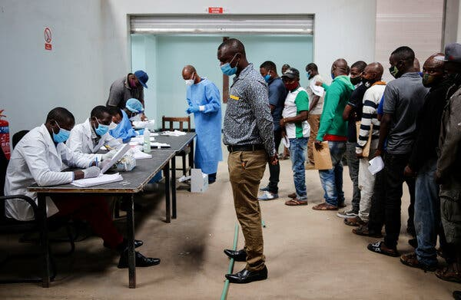
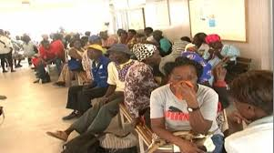
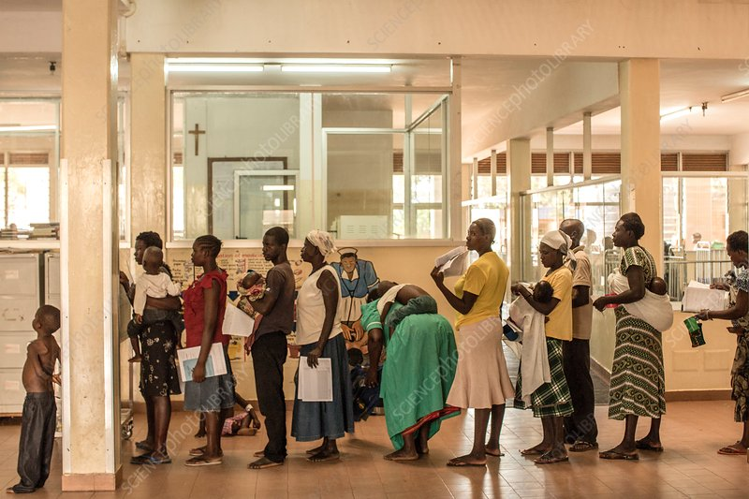
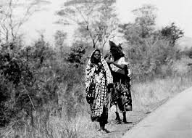
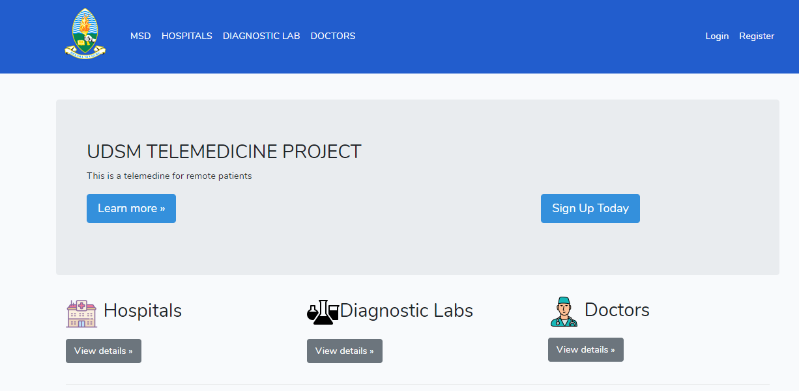
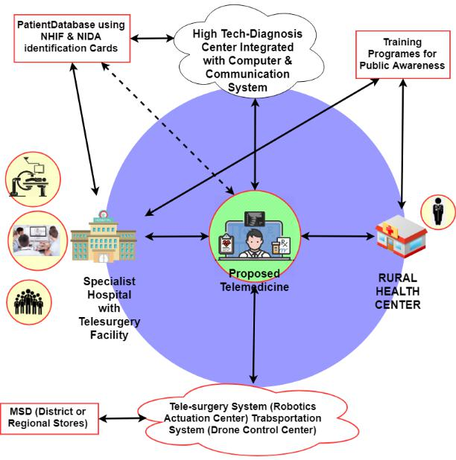
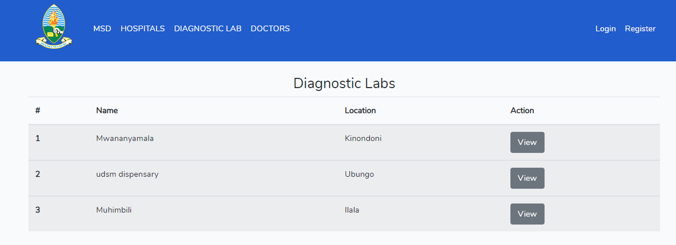
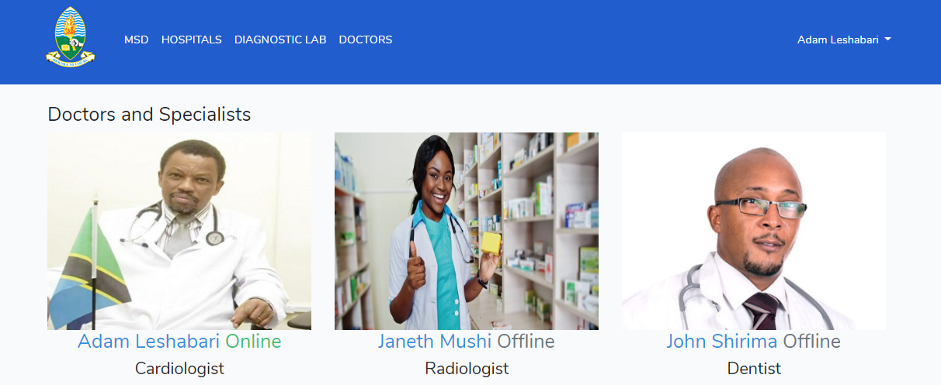
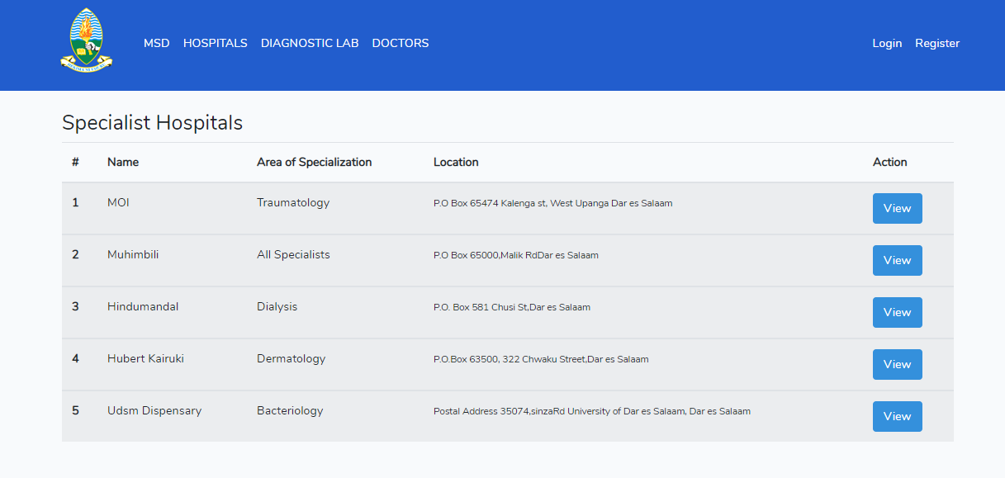


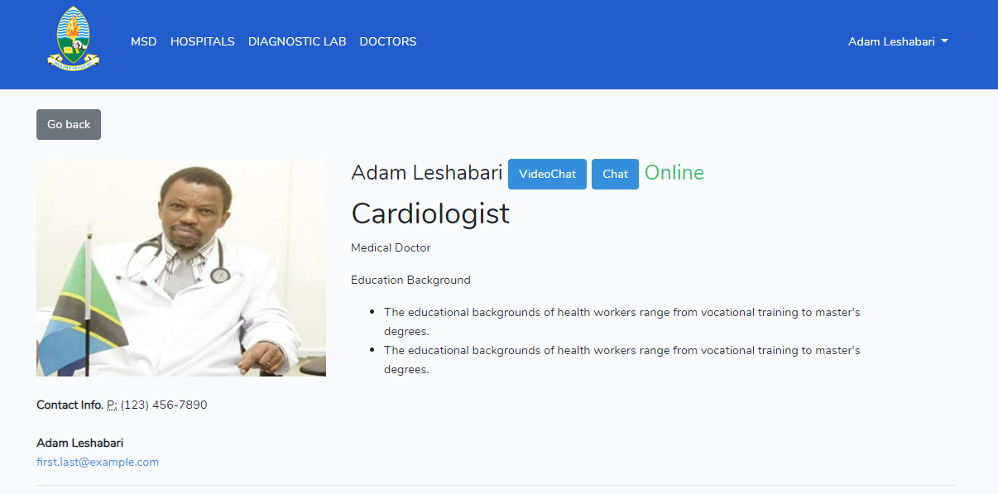
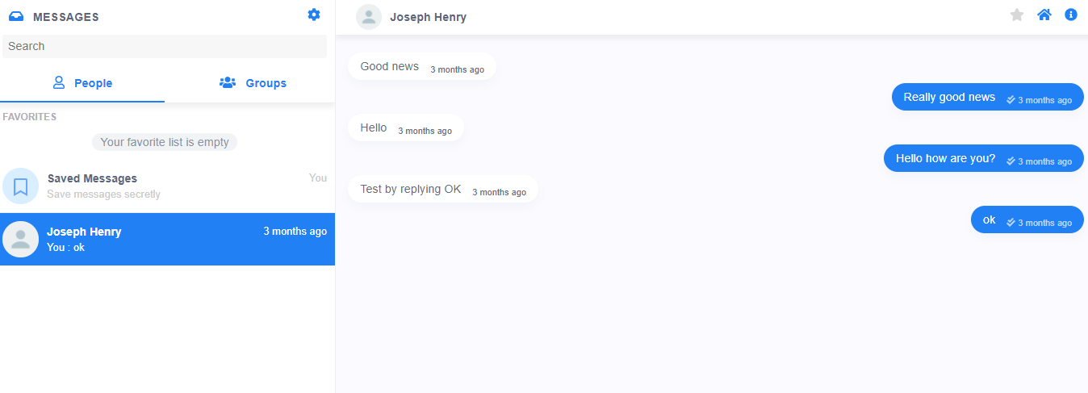


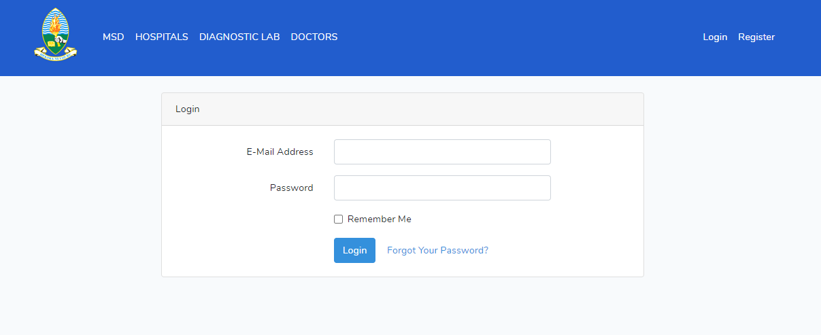
6th International Conference in Mechanical and Industrial Engineering (MIE' 2020)
DEVELOPMENT OF INTEGRATED TELEMEDICINE INFRASTRUCTURE
FOR ACCESS TO SPECIALIST DOCTORS FOR RURAL COMMUNITIES
IN TANZANIA
Dr. Jackson J. Justo, Eng. Joseph Sisala, Dr. Aviti T. Mushi, Dr. Jestina Katandukila, Dr. Irene M. Lugala, Eng. Ally Bitebo, Dr. Fred Chibwana, Dr. Richard Katemi, Dr. Alphonce W. Wikedzi, Dr. Mussa D. Budeba
FUNDER: UDSM COMPENTETITIVE RESEARCH AND INOVATION GRANTS 2019/2020
1. Abstract
2. Problem Description of the Current Situation
Significance of this Research
Better and efficient medical specialist consultation and prognosis, thus hastening recovery and improve quality of life
Opportunity of new application of ICT that will enhance early and quick diagnosis
Contribute significantly to sustainable health services where by medical services and devices will be easily accessible to Tanzanian rural community and other countries in East and Southern Africa
Creation of more employment opportunities. This will include both direct and indirect employments thus increasing people’s income
Capacity building of integrated medical care services, robotics, control system, telecommunications as well as telemedicine
Avoidance of long bureaucratic needed during seeking medical services in the country
Objectives of this Research
To develop a telemedicine system using available technologies by linking the patients living in remote areas and the available specialists in big cities such as that depicted in the proposed system solution.
To establish a Tanzanian based model suitable for health services interlinking between the health center in rural areas and the specialist hospitals or referral hospitals.
To develop a controlled patient information sharing platforms between various health care providers in Tanzania and patient-doctor mobile applications packages.
To integrate the available infrastructures that can facilitate reliability of the health service stakeholders, doctors to patient consultation.
Handling of Patients information is problematic
Patients are forced to move long distance to look for medical care
At pharmacies and hospitals there are long queues – wastage of time and prone to contagious diseases
3. Proposed Solution & Progress Made Towards Accomplishment
5. References
1) Akter, S., Ray, P. and D’Ambra, J., 2013. Continuance of mHealth services at the bottom of the pyramid: the roles of service quality and trust. Electronic Markets, 23(1), pp.29-47.
2) Bloor, K., Hendry, V. and Maynard, A., 2006. Do we need more doctors? Journal of the Royal Society of Medicine, 99(6), pp.281-287.
3) Peabody, J.W., Taguiwalo, M.M., Robalino, D.A. and Frenk, J., 2006. Improving the quality of care in developing countries. doi.org/10.1596/978-0-8213-6179-5.
4) Shiferaw, F. and Zolfo, M., 2012. The role of information communication technology (ICT) towards universal health coverage: the first steps of a telemedicine project in Ethiopia. Global health action, 5(1), p.15638.
5) Mwammenywa, I.A. and Kaijage, S.F. (2018). Towards enhancing access of HIV/AIDS healthcare information in Tanzania: Is a mobile application platform a way forward? I.J. Information Technology and Computer Science, 2018, 7, pp. 31-38.
6) The World Bank Group, (2019), Rural population (% of total population), https://data.worldbank.org/indicator/SP.RUR.TOTL.ZS?locations=TZ, accessed August 27th 2019.
7) Senkoro E.M., (2018), What it takes to improve rural health. The citzen,
https://www.thecitizen.co.tz/magazine/What-it-takes-to-improve-rural-health/1840564-
4494354-11dqq5yz/index.html, accessed 15th August 2019.
4. Conclusions
Expected Outputs:
Availability of working prototype of the telemedicine infrastructure will be developed and the software for functioning of the system will be generated

